Slide 1
Landing/Opening Page
Full-screen graphic: KRIES logo, CMCA logo + upbeat welcome music.
On-screen text: “Welcome to the Children’s Constitution Club!”

Slide 2
Diversity in classroom
Recall Bar
Diversity in classroom
On screen text:
Look at your classmates around you and find something you have in common with one of them
Now look around and find something that makes you different from your classmate
Just like we have things in common and things that make us unique, so does the whole country!

Slide 3

Creative expression (optional activity)
Recall Bar
Diversity in classroom
Creative expression (optional)
On screen text:
Look at the shapes, textures, colour, imperfections on the leaf
In your notebooks, draw the leaf from your observation - crayons, colour pencils, or simple line drawings – your choice!
Capture as many details as you can in your own style
Countdown timer: 10 minutes
Reminder: 3 minutes

Slide 4
Diversity in India
Recall Bar
Diversity in classroom
Creative expression (optional)
Diversity in India
On screen text:
We will now explore India’s diversity through our many states! Make sure you are all seated in your groups
Teacher to distribute State Information Cards (Annexure 1) to groups as follows and Annexure 2 to all groups
  Group 1: Rajasthan, Kerala
  Group 2: Assam, Maharashtra
  Group 3: Tamil Nadu, Manipur
  Group 4: Odisha, Punjab
  Group 5: Karnataka, Kashmir
Note for teacher: Explain/remind students about the school profile in case they don’t remember
Notes:
Creative expression - use latest guide - add in introduction part

Slide 5
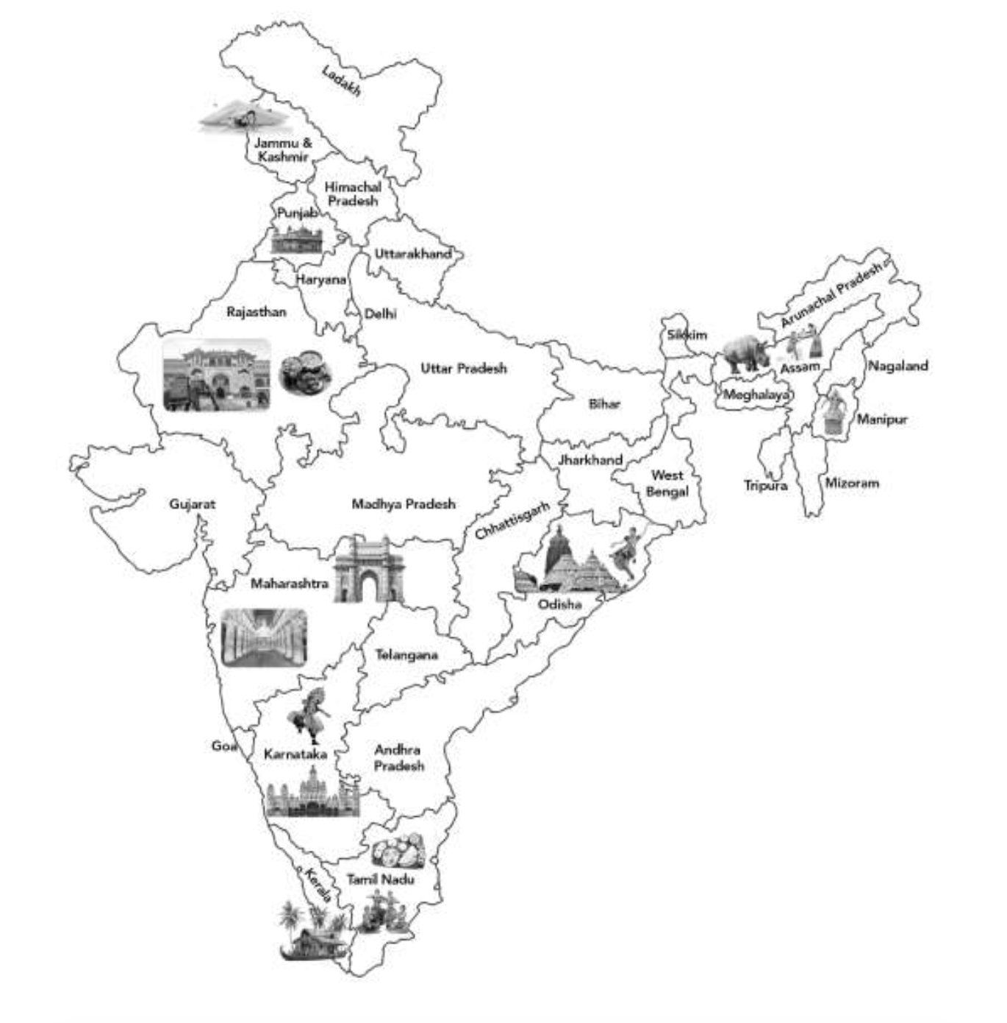
Diversity in India
Recall Bar
Diversity in classroom
Creative expression (optional)
Diversity in India
On screen text:
Look at the Information Card and discuss what’s special about the states!
Identify the states in the map
Note down 2 or more interesting things about each state/draw something/write down fun facts you know about the language
Countdown timer: 7 minutes
Reminder: 3 minutes
Note for teacher: Explain/remind students about the school profile in case they don’t remember

Slide 6

Quiz on diversity
Recall Bar
Diversity in classroom
Creative expression (optional)
Diversity in India
Quiz on diversity
On screen text:
We will now have a fun quiz!
Each correct answer will give a group 100 points!
Along with the answer, we will also be dancing
Are you ready? Let’s go!
Note for teacher: Explain/remind students about the school profile in case they don’t remember

Slide 7
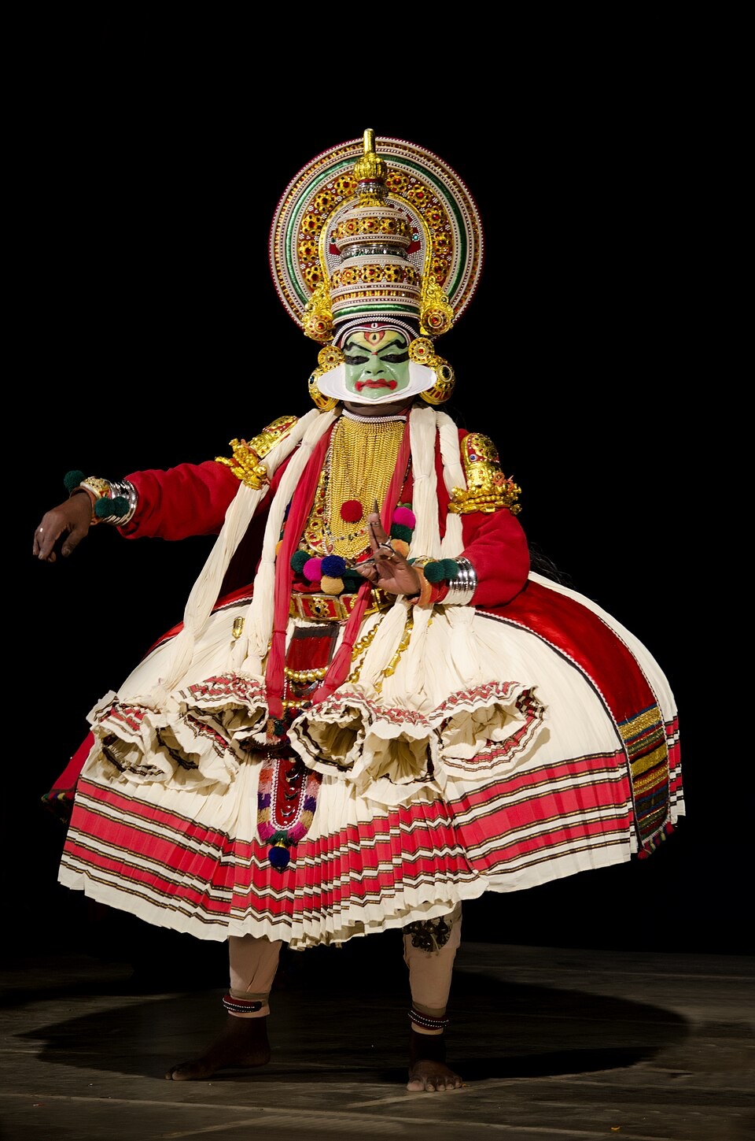
Quiz question 1
Recall Bar
Diversity in classroom
Creative expression (optional)
Diversity in India
Quiz on diversity
On screen text:
Which dance form involves dramatic storytelling with colourful costumes and intricate gestures, and is performed in Kerala?
Kathakali Dance!
Dance Move: Strike a "Kathakali Pose" with strong hand gestures and dramatic expressions!
Note: Play a 30 second Kathakali youtube video in class
Note for teacher: Explain/remind students about the school profile in case they don’t remember

Slide 8
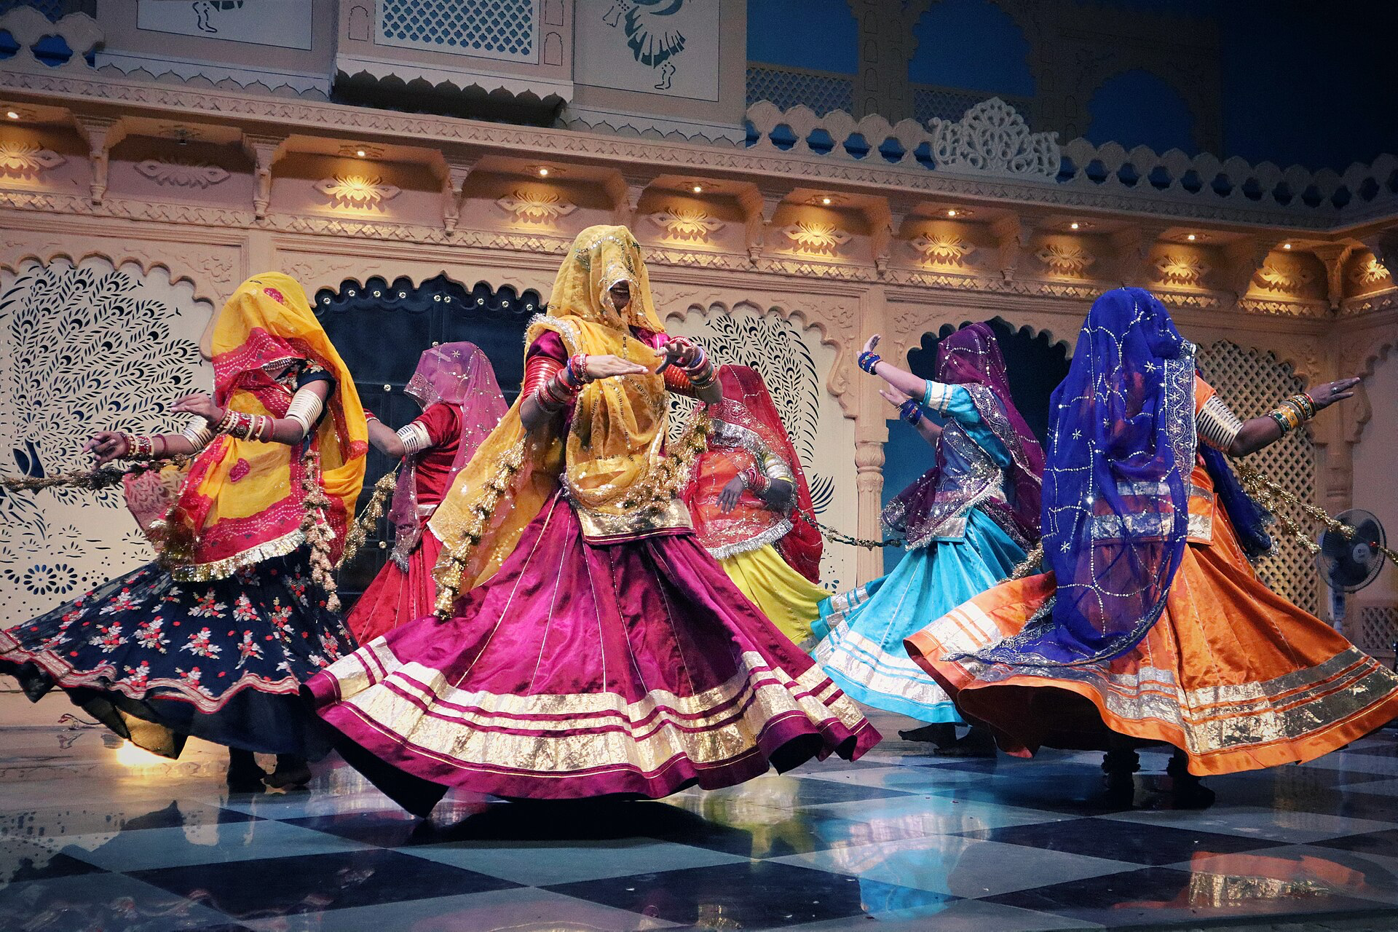
Quiz question 2
Recall Bar
Diversity in classroom
Creative expression (optional)
Diversity in India
Quiz on diversity
On screen text:
This famous landmark, known for its grand architecture, is located in Rajasthan and is a UNESCO World Heritage site. It also served as a royal palace.
Amber Fort!
Dance Move: Perform a “Ghoomar Spin” to celebrate the regal grandeur of Rajasthan.
Note: Play a 30 second Ghoomar youtube video
Note for teacher: Explain/remind students about the school profile in case they don’t remember
Notes:
Aali Jain, License CC BY-SA, https://commons.wikimedia.org/wiki/File:Ghoomar_dancers_%28Rajasthan,_India,_2023%29.jpg

Slide 9
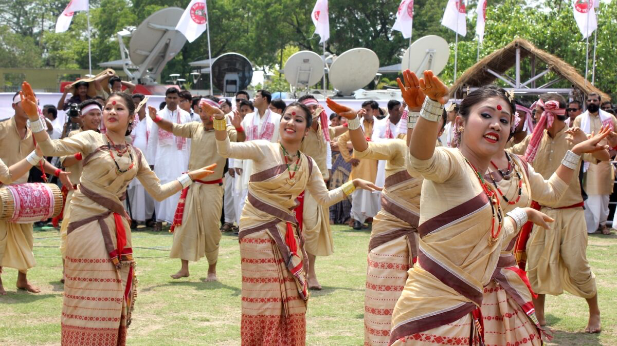
Quiz question 3
Recall Bar
Diversity in classroom
Creative expression (optional)
Diversity in India
Quiz on diversity
On screen text:
What is the traditional clothing worn by women in Assam, which is known for its
silk weaving tradition?
Muga Silk Sarees!
Dance Move: Perform the "Bihu Step" - an energetic foot tap from Assam’s famous
dance.
Note: Play a 30 second Bihu dance youtube video
Note for teacher: Explain/remind students about the school profile in case they don’t remember
Notes:
Bihu dance performance in Guwahati Assam. Image by Subhrajit via Wikimedia Commons. CC BY-SA 3.0

Slide 10
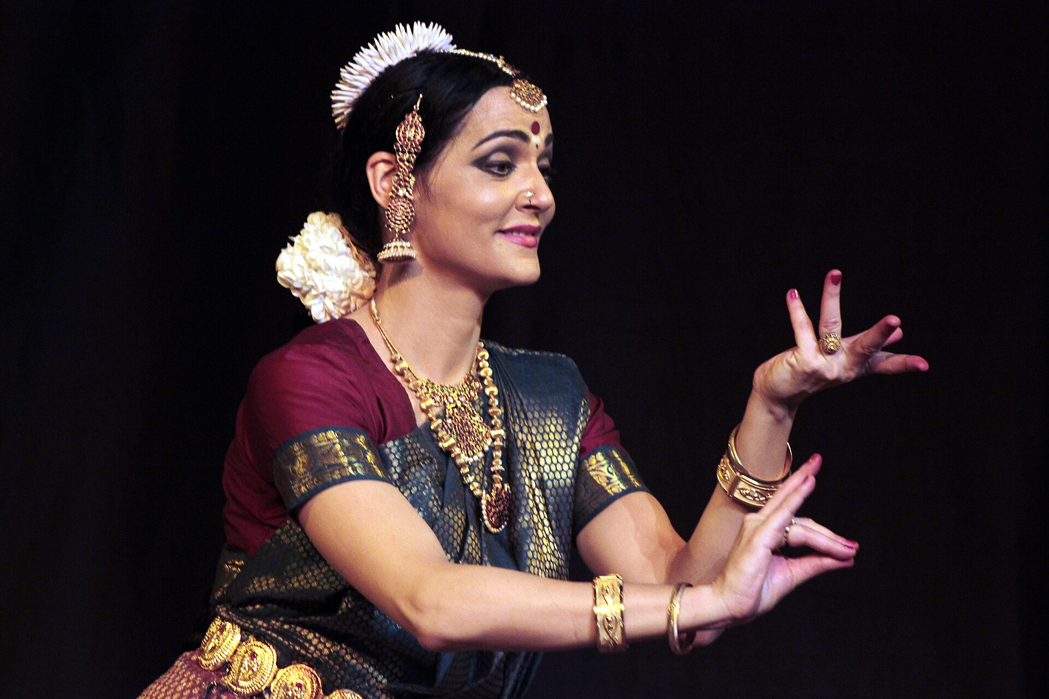
Quiz question 4
Recall Bar
Diversity in classroom
Creative expression (optional)
Diversity in India
Quiz on diversity
On screen text:
This South Indian state is famous for its crispy, golden-brown dosa, a popular dish
often enjoyed with chutney and sambar. Can you name the state?
Karnataka/Tamil Nadu!
Dance Move: Perform a graceful “Bharatanatyam Mudra” to celebrate the food.
Note: Play a 30 second Bharatnatyam dance youtube video
Note for teacher: Explain/remind students about the school profile in case they don’t remember
Notes:
Bharatanatyam Facial expressions, Suyash Dwivedi, CC BY-SA 4.0 https://commons.wikimedia.org/wiki/File:Bharatnatym_Mudra_(45).jpg

Slide 11
Quiz question 5
Recall Bar
Diversity in classroom
Creative expression (optional)
Diversity in India
Quiz on diversity
On screen text:
Which state is famous for its tea plantations, rich cultural traditions, and the festival
Bihu?
Assam!
Dance Move: Tap your feet in the "Bihu Step" to the rhythm of the festival!
Note for teacher: Explain/remind students about the school profile in case they don’t remember

Slide 12
Recall Bar
Diversity in classroom
Creative expression (optional)
Diversity in India
Quiz on diversity
MC to appear and say
Hello everyone! Sorry for the interruption! Are you all enjoying the quiz? I just wanted to say hi!
Isn’t it amazing how diverse our country is? What do you enjoy the most about our country’s diversity - the food, clothing, dance, cultures or the beautiful landscapes? Just something to think about!
Alright carry on with the quiz now! See you soon!
Note for teacher: Explain/remind students about the school profile in case they don’t remember

Slide 13
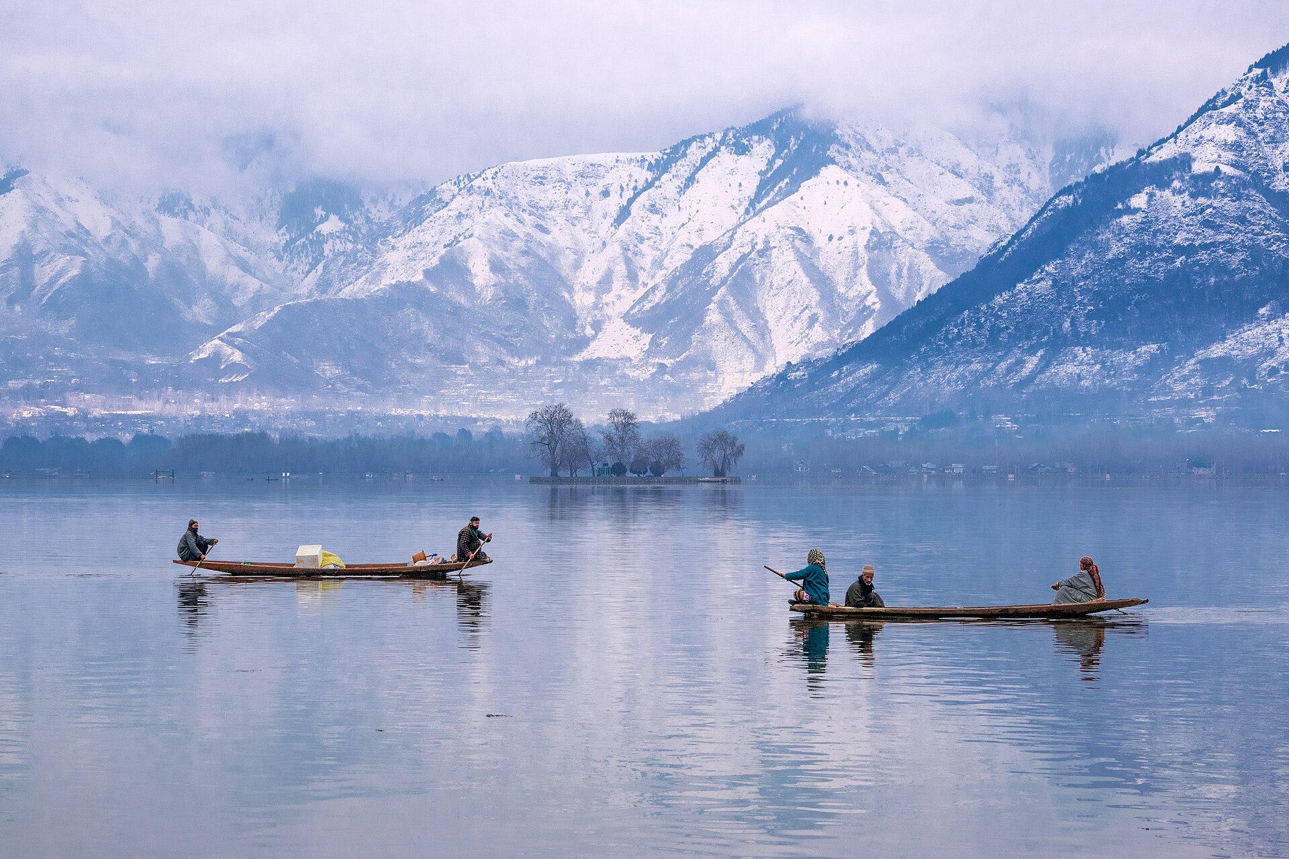
Quiz question 6
Recall Bar
Diversity in classroom
Creative expression (optional)
Diversity in India
Quiz on diversity
On screen text:
Which landmark in Kashmir is famous for its scenic beauty and boat rides?
Dal Lake!
Dance Move: Perform a graceful hand gesture to imitate the serene movements of a
boat on the lake.
Note for teacher: Explain/remind students about the school profile in case they don’t remember
Notes:
https://en.wikipedia.org/wiki/Dal_Lake#/media/File:Dal_Lake_Hazratbal_Srinagar.jpg, View of Dal Lake, Suhail Skindar Sofi, CC BY-SA 4.0

Slide 14
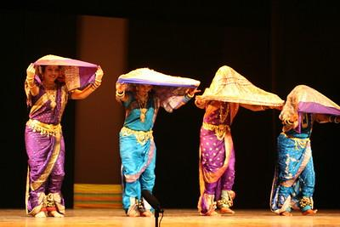
Quiz question 7
Recall Bar
Diversity in classroom
Creative expression (optional)
Diversity in India
Quiz on diversity
On screen text:
The famous Gateway of India, a historical monument, is located in which state that
also celebrates festivals like Ganesh Chaturthi and Makar Sankranti?
Maharashtra!
Dance Move: Perform a “Lavani Step,” full of energy and rhythm from Maharashtra’s
famous dance.
Note: Play a Lalvani youtube video
Note for teacher: Explain/remind students about the school profile in case they don’t remember
Notes:
https://www.flickr.com/photos/ramesh_lalwani/4901588236, CC BY 2.0
Ramesh Lalwani

Slide 15
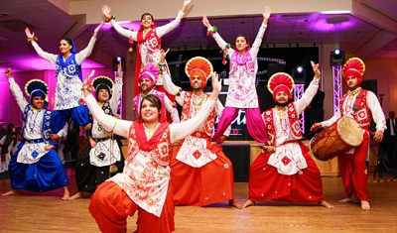
Quiz question 8
Recall Bar
Diversity in classroom
Creative expression (optional)
Diversity in India
Quiz on diversity
On screen text:
This dish, made of maize and mustard greens, is a traditional food enjoyed in
Punjab, especially in the winter. What is it called?
Sarson da Saag and Makki di Roti!
Dance Move: Do the “Bhangra Jump” to celebrate Punjab’s harvest traditions!
Note: Play a 30 second bhangra youtube video
Note for teacher: Explain/remind students about the school profile in case they don’t remember
Notes:
Bhangra, Jaipuneetsingh, CC BY-SA 4.0 https://en.wikipedia.org/wiki/Bhangra_(dance)#/media/File:Bhangra-dance.jpg

Slide 16
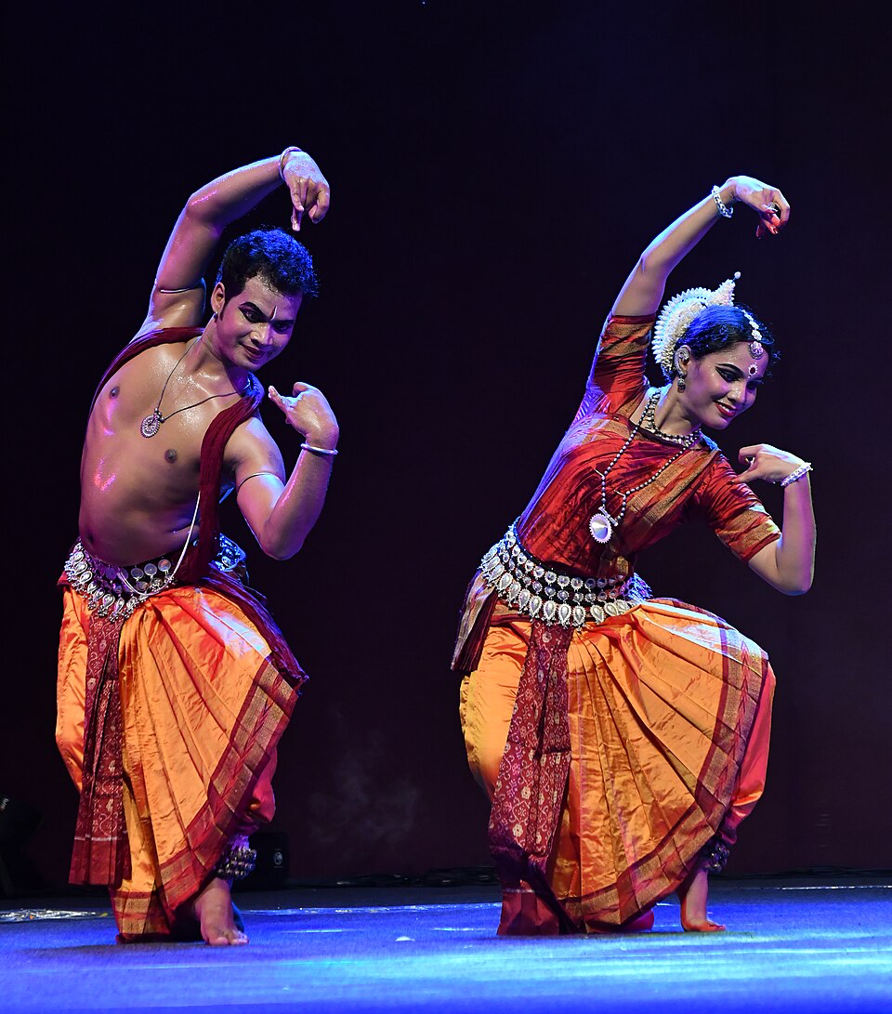
Quiz question 9
Recall Bar
Diversity in classroom
Creative expression (optional)
Diversity in India
Quiz on diversity
On screen text:
Which state is known for its ancient temples, including the Jagannath Temple, and celebrates the Rath Yatra festival with grand processions?
Odisha!
Dance Move: Strike an elegant “Odissi Pose” to honor the classical dance from Odisha.
Note: Play a 30 second Odissi video
Note for teacher: Explain/remind students about the school profile in case they don’t remember
Notes:
Odissi dance, Shagil Kannur, CC BY-SA 3.0 https://en.wikipedia.org/wiki/Odissi#/media/File:Odissi_dance_at_Nishagandi_Dance_Festival_2024_(207).jpg

Slide 17
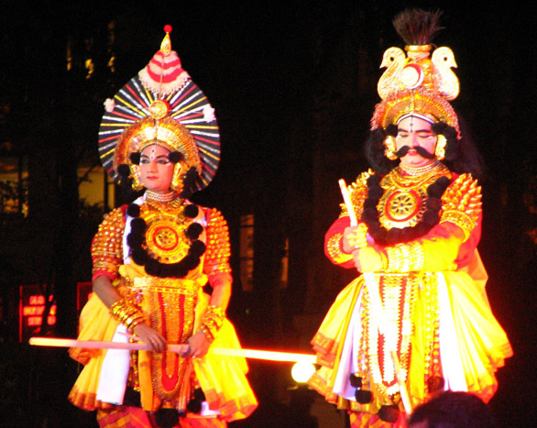
Quiz question 10
Recall Bar
Diversity in classroom
Creative expression (optional)
Diversity in India
Quiz on diversity
On screen text:
This state is famous for its Mysore Palace, rich history, and the festival of
Dussehra. What is this state?
Karnataka!
Dance Move: Perform the "Yakshagana Step," a bold, dramatic movement from Karnataka’s traditional dance.
Note: Play a 30 second Yakshagana youtube video
Note for teacher: Explain/remind students about the school profile in case they don’t remember
Notes:
Deepak Shetty, CC BY-SA 3.0 https://en.wikipedia.org/wiki/Yakshagana#/media/File:Yakshaganads.jpg

Slide 18
Discuss the quiz
Recall Bar
Diversity in classroom
Creative expression (optional)
Diversity in India
Quiz on diversity
What was the most fun part of today’s quiz and dance?
What did you learn about the states today that you didn’t know before?
Did any of the dance steps remind you of your own culture or family traditions?
Note for teacher: Explain/remind students about the school profile in case they don’t remember

Slide 19
Social diversity
Recall Bar
Diversity in classroom
Creative expression (optional)
Diversity in India
Quiz on diversity
Social diversity
MC to say:
You all did an amazing job dancing, guessing, and sharing what makes each state so special!
What we explored today is called social diversity. Social diversity refers to the variety
of cultures, languages, traditions, and lifestyles that exist in a society. Just as we saw
today, India is home to many different states, each with its own unique identity. These differences make our country vibrant and rich. Celebrating these differences makes us grow together!
Note for teacher: Explain/remind students about the school profile in case they don’t remember

